Slide 1

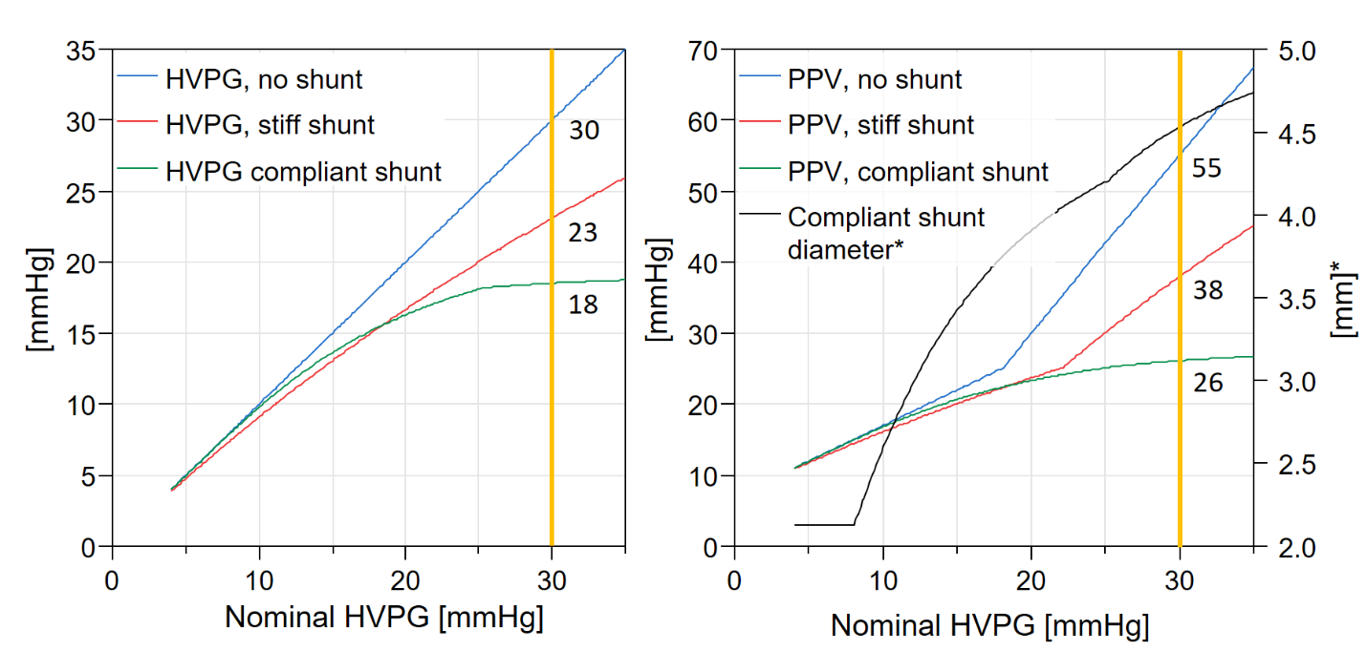
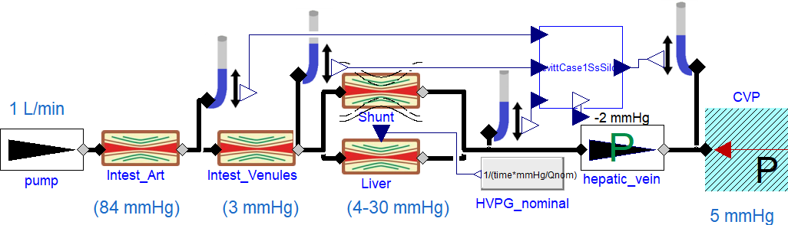
Underestimating Portal Hypertension Severity due to Collateral Shunts
Filip Jezek¹, Nikhilesh R. Mazumder², Dan A. Beard¹
1 Department of Molecular and Integrative Physiology
2 Division of Gastroenterology and Hepatology
University of Michigan, Ann Arbor, MI, USA; e-mail: fjezek@ umich.edu
PURPOSE / OBJECTIVES
A simple model of portal system uncovers obvious but overlooked relation
At nominal HVPG of 30 mmHg, the compliant shunt effectively limits both the apparent HVPG and PPV, by shunting up to half the flow.
Resulting shunt dilation may however lead to life-threatening variceal ruptures.
RESULTS
Cirrhosis progressively alters portal circulation, ranging from asymptomatic portal vein pressure increases to life threatening decompensating events such as variceal bleeding and ascites [1]
Hepatic venous pressure gradient (HVPG) is commonly used as a measure of severity of cirrhosis, but HVPG is influenced by volume flow rate in the portal vein (PV) and proportion of portal flow through collaterals.
With increasing luminal diameter, a large amount of portal vein flow is shunted, decreasing the HVPG, masking the true liver resistance.
More complete hemodynamic analysis of the portal system are needed to understand portal hypertension and its progression
5.0
Compliant shunt
0.5
Compliant shunt
4.5
Stiff shunt
0.4
Stiff shunt
4.0
0.3
[mm]
3.5
[l/min]
0.2
3.0
0.1
2.5
2.0
4
8
12
HVPG [mmHg]
16
20
24
0.0
4
8
12
16
20
24
HVPG [mmHg]
Figure 3: Change in shunt diameter (left) and flow (right) to HVPG. Compliant shunts are assumed to remodel, increasing their diameter over time. Larger lumen allows for higher shunt flow, reducing the HVPG.
MATERIAL & METHODS
0-D model of the isolated splanchnic hemodynamics (fig 1), based on the steady state Levitt’s and Levitt’s model [2] calculates ascites pressure, HVPG and PPV at nominal inflow rate of 1L/min.
Collateral shunts from portal vein into the vena cava: long-term remodeling causes tiny vessels to grow in diameter as a function of portal pressure
Detailed model description is at [3].
Simulated portal vein pressure (PPV) and HVPG while increasing liver resistance
Liver resistance was quantified by the 'nominal HVPG' (zero shunting), with a fixed-diameter shunt, and with our novel compliant shunt.
The porto systemic shunts affects the hepatic circulation and masks the true liver damages
Compliant shunt lowers HVPG and PPV, but risk of rupture (compare the change in diameter)
Large shunt divert large portion of splanchnic flow around the liver
Further investigation: Does the splanchnic circulation keep its 1 L/min throughput?
Further investigation: TIPS placement
Do you want to try yourself? https://filip-jezek.github.io/Ascites/
References
G. D’Amico, G. Garcia-Tsao, and L. Pagliaro, “Natural history and prognostic indicators of survival in cirrhosis: a systematic review of 118 studies,” J. Hepatol., vol. 44, no. 1, pp. 217–231, Jan. 2006.
D. G. Levitt and M. D. Levitt, “Quantitative modeling of the physiology of ascites in portal hypertension,” BMC Gastroenterol., 2012.
F. Ježek, Ascites: ascites modeling. Github. Accessed: Apr. 04, 2022. [Online]. Available: https://github.com/filip-jezek/Ascites
Figure 2: Increase of HVPG and PPV for nominal (no shunts), stiff and novel compliant shunt model with respect to the increasing liver resistence (represented by the nominal HVPG).
Figure 1: Model of portal circulation. Left to right: pump, resistance of intestinal arteries, intestinal veins and liver with parallel shunt, constant pressure drop at hepatic vein and central venous pressure

